Slide 1
Group Name
Employer ID: CHO
Name Here
Title Here

Slide 2
Instructions: Find and Replace
Delete This Slide Before Presenting
Getting Started:
Enrollment presentations can be shown to employees to help explain how to use their Choice Strategies plan.
  Before showing this presentation to employees, please customize it by finding and replacing the following:
    Group Name: Group Name
    Health Insurance Carrier: Carrier
    Plan Year: 00/00/0000-00/00/0000
    Plan Start Date: 00/00/0000
    FSA Maximum: $2,650

Slide 3

Flexible Spending Account (FSA)
Plan Year: 00/00/0000-00/00/0000
Key Features
Funding
Eligible Expenses
Employer Owned
  Less payroll taxes!
Employee Funded
  Pre-tax contributions per pay period
Prefunded
  Employees have access to funds from day 1 of the plan year
IRS Contribution limit
  $2,650 pre-tax
All IRS eligible medical expenses
  IRS Publication 502
  WageWorks eligible expense list
    Doctor Office visits
    Hospital visits
    Copays & Coinsurance
    Prescriptions
    Some Over-the-Counter products
    Vision
    Dental
    And More!

Slide 4

The Grace Period
What Is It?
My Plans Grace Period
A 2 ½ month period of time that extends the plan year so that participants can use any remaining funds
Choice Strategies Card can be used during this time
  For previous year expenses
  For expenses incurred during the Grace period
Plan Year
  00/00/0000-00/00/0000
Grace Period
  00/00/0000-00/00/0000

Slide 5

The FSA Carryover
What Is It?
Example
A provision for FSAs that allows up to $500 to carryover from year to year
The carryover amount does not impact how much someone can contribute in the following year
John had a previous year FSA for $2,550
He spent all but $500
The $500 carried over into his new FSA
He choose to elect the full IRS maximum of $2,650 for his new FSA
John now has a new FSA with a balance of $3,150

Slide 6

Dependent Care Account (DCA)
Plan Year: 00/00/0000-00/00/0000
Key Features
Funding
Eligible Expenses
Employer Owned
  Less payroll taxes!
Employee Funded
  Pre-tax contributions per pay period
Funds Accumulate
  Money can only be used as funded into the account
IRS Contribution limit
  $5,000 pre-tax
    Married and filing jointly
  $2,500 pre-tax
    Married and filing separately
All IRS eligible custodial care expenses
  WageWorks eligible expense list
    Babysitting (work related, not provided by tax dependent)
    Before or after school programs (primarily custodial)
    Custodial elder care
    Nanny
    Preschool
    Summer day camp
    Transportation to and from eligible dependent care

Slide 7
FSA Savings Examples
Without FSA / DCA
Gross Monthly Salary | $2,500.00
Less:
Federal Income Tax | $333.61
State Income Tax | $174.79
FICA Tax | $191.25
Net Income | $1,800.35
Less:
Health Care Expenses | $200.00
Dependent Care | $400.00
Spendable Income | $1,200.35
With FSA/DCA
Gross Monthly Salary | $2,500.00
Less:
Health Care Expenses | $200.00
Dependent Care | $400.00
Taxable Income | $1,900.00
Less:
Federal Income Tax | $253.54
State Income Tax | $132.84
FICA Tax | $145.35
Spendable Income | $1,368.27
Monthly Savings | $167.92
Annual Savings | $2,015.04

Slide 8
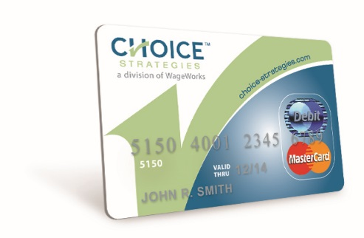
The Choice Strategies Card
Key Features
1 card
  Even if there are multiple accounts
Swipe as Credit vs. Debit
  Access to the PIN if needed, is on the “My Card” tab in the member online account
Card activates upon first use for an eligible expense
  Within the available balance on the plan
Spouses automatically receive their own card
  Dependent cards can be issued upon request, free of charge

Slide 9
Payment Example:
Medical Deductible Expenses
Present health insurance carrier ID card
Complete visit with the healthcare provider
Provider will submit information to health insurance carrier
Provider will issue a detailed bill or statement
Pay the bill using the Choice Strategies Card
Provide the card number on the provider bill within the billing section
Carrier will make adjustments and issue an Explanation of Benefits (EOB)
Pay copay if applicable

Slide 10
Payment Example:
Prescription Expenses
Bring the prescription to pharmacy
Pharmacist will advise of the prescription price
Make sure that the pharmacy has your updated insurance/benefit information
Pay the bill using the Choice Strategies Card
Swipe the card as credit vs. debit for your convenience
IIAS (Inventory Information Approval System)
  No Request for documentation on Rx charges if IIAS Approved Pharmacy is used. (List available on www.choice-strategies.com)

Slide 11
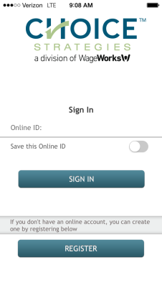
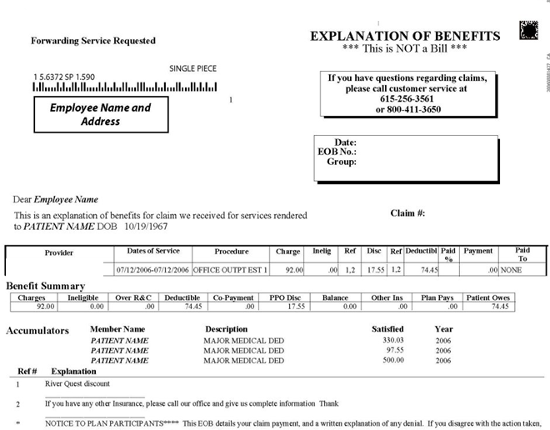
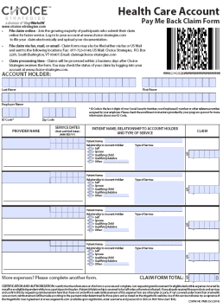
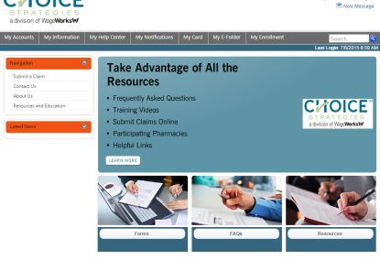
Submitting a Claim
Online
Mobile App
Paper
Instructional video available
  Processing time is about 1-3 business days
  Only 2 more days to receive reimbursement if signed up for direct deposit
Instructional video available
  Take pictures of your supporting documentation and upload directly to transactions / claim submissions
Fax:1-877-723-0148
Mail: P.O. Box 2205, South Burlington, VT 05407
Member Forms Page

Slide 12
Documentation Requirements
Requirement
No Response?
The IRS states that supporting documentation must be supplied for card transactions used with tax advantaged benefits.
  Keeps a company’s plan in compliance
Card will be placed in a temporarily inactive state until the transaction can be resolved
  Resolution occurs when appropriate documentation is sent or a refund is made to the account
Your Responsibility
Respond to documentation requests made by Choice Strategies
  Notices are sent via email or mail.
    Always email, if on file
    Multiple notices sent
Appropriate documentation includes:
  Explanation of Benefits
  Detailed Provider's bill or statement

Slide 13




Online Account & Mobile Application
Online Account
Mobile App
Training Video:
  https://www.brainshark.com/ccc/NewMemberPortalOverview
Training Video:
  https://www.brainshark.com/ccc/CSMobileApp
Features
Available Balance
Transaction History
Upload Supporting Documents
Card Status
Update Personal Information
Submit Claims Online

Slide 14
Phone: 888-278-2555 (Option 2)

