Slide 1
Group Name
Employer ID: CHO
Name Here
Title Here

Slide 2
Instructions: Find and Replace
Delete This Slide Before Presenting
Getting Started:
Enrollment presentations can be shown to employees to help explain how to use their Choice Strategies plan.
  Before showing this presentation to employees, please customize it by finding and replacing the following:
    Group Name: Group Name
    Health Insurance Carrier: Carrier
    Plan Year: 00/00/0000-00/00/0000
    Plan Start Date: 00/00/0000
    TRN Monthly Maximum: $260
    PKG Monthly Maximum: $260

Slide 3

Commuter Plans: Parking & Transit
Key Features
Funding
Eligible Expenses
Employer-owned
  Reduced payroll taxes!
Employee-funded
  Pre-tax contributions per pay period
Funds Accumulate
  Money becomes available as it is funded into the account
Funds roll over year to year
Only for the commuting employee
Elections can be changed at any time
IRS Contribution limit
  Parking: $260 pre-tax per month
  Transit: $260 pre-tax per month
WageWorks eligible expense list
  Parking (work related)
    Parking lots
    Parking Garages
  Transit (work related)
    Bus
    Ferry
    Subway
    Train
    Vanpool
    Bicycle storage and repair

Slide 4
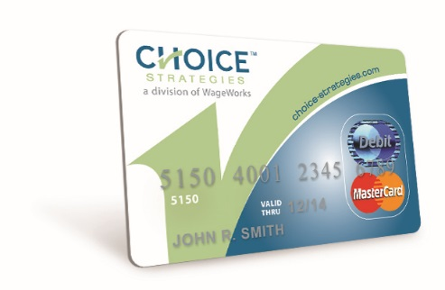
The Choice Strategies Card
Key Features
1 card
  Even if there are multiple accounts
Swipe as Credit vs. Debit
  Access to the PIN if needed, is on the “My Card” tab in the member online account
Card activates upon first use for an eligible expense
  Within the available balance on the plan
Spouses automatically receive their own card
  Dependent cards can be issued upon request, free of charge

Slide 5
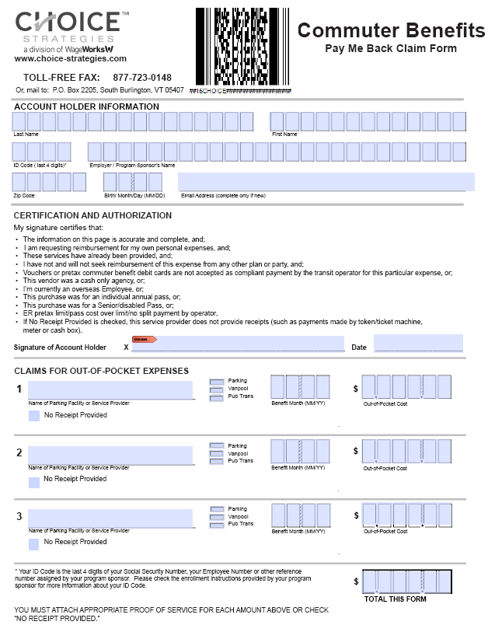
Submitting a Claim
Paper
Fax:1-877-723-0148
Mail: P.O. Box 2205, South Burlington, VT 05407
Member Forms Page

Slide 6
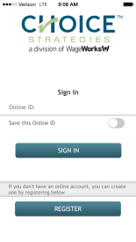

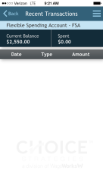
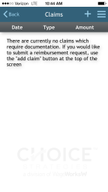
Online Account & Mobile Application
Online Account
Mobile App
Training Video:
  https://www.brainshark.com/ccc/NewMemberPortalOverview
Training Video:
  https://www.brainshark.com/ccc/CSMobileApp
Features
Available Balance
Transaction History
Upload Supporting Documents
Card Status
Update Personal Information
Submit Claims Online

Slide 7
Phone: 888-278-2555 (Option 2)

